Slide 1

Organizational Behavior
(MGT-502)
Lecture-29

Slide 2
Today’s Topics

Slide 3
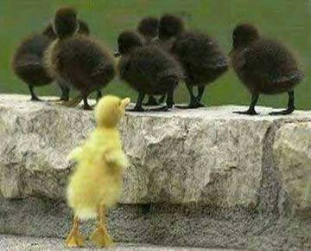
Why Do We Study OB?

Slide 4
Understand
organizational
events
Organizational
Behavior
Research
Influence
organizational
events
Predict
organizational
events

Slide 5

People in Organizations
Understanding the basic nature of the individual-organization interface helps us appreciate the nature of individual differences. These differences, in turn, play a critical role in determining various important workplace behaviors of special relevance to managers.

Slide 6
Individual Vs Group Behavior

Slide 7
Individual Differences
Individual Differences
  Personal attributes that vary from one person to another.
  Individual differences include personality, attitudes, perception, and creativity.

Slide 8
Understanding the Basics of Human Behavior

Slide 9
Heredity
Environment
Individual
Differences
Framework
Abilities
and Skills
Values
Work-Related
Attitudes
Work-Related
Behaviors

Slide 10
Variables Influencing
Individual Behavior

Slide 11
The Person
Skills & abilities
Personality
Perceptions
Attitudes
Values
Ethics
The Environment
Organization
Work group
Job
Personal life
Behavior
B = f(P,E)

Slide 12
Types of work-related behaviour
Joining the
organisation
Types of
work-related
behaviour
Exhibiting
organisational
citizenship
Remaining
with the
organisation
Performing
required
tasks
Maintaining
work
attendance

Slide 13
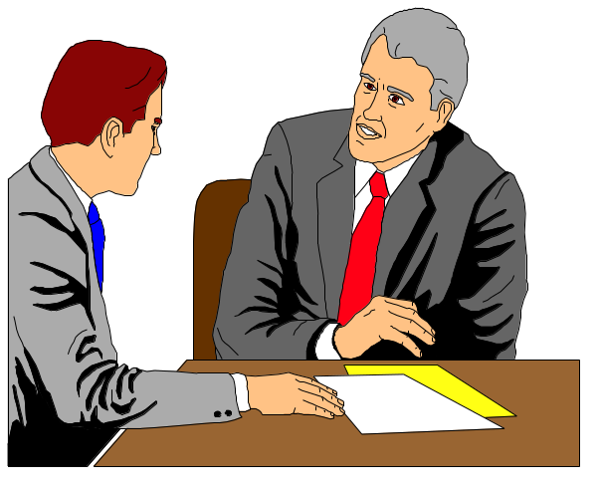
The Person-Job Fit
Person-Job Fit
  The extent to which the contributions made by the individual match the inducements offered by the organization.

Slide 14
Ability
Mental and physical capabilities to perform various tasks.

Slide 15
The Importance of Values
Behavior
Motivation
Perceptions
Attitudes
Values

Slide 16
Values, Loyalty, and Ethical Behavior
Ethical Climate in
the Organization
Ethical Values and Behaviors of Leaders

Slide 17
Components of Attitudes
Cognitive -- thinking
Affective -- feeling
Behavioral -- doing

Slide 18
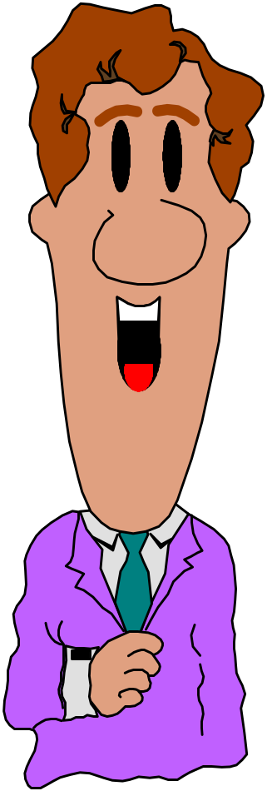
Types of Attitudes
Job satisfaction
Job involvement
Organizational commitment

Slide 19
Personality
Mean how people affect others and how they understand and view themselves, as well as their pattern of inner and outer measurable traits and
Person-situation interaction

Slide 20
Locus of Control
Locus of Control - personality variable that affects individual behavior
  Internal - belief in personal control and personal responsibility
  External - belief in control by outside forces (fate, chance, other people)
Notes:
23

Slide 21
Because personality characteristics create the parameters for people’s behavior, they give us a frame work for predicting behavior.

Slide 22
Emotions and Mood

Slide 23
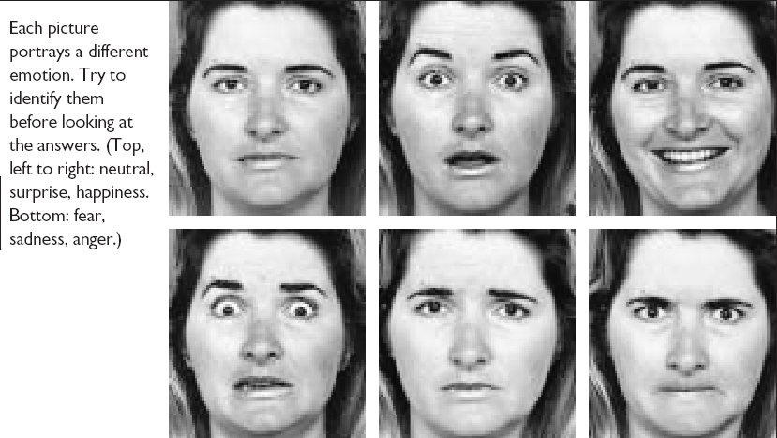
Facial Expressions Convey Emotions

Slide 24
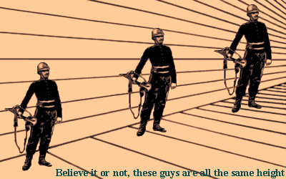
Individual Behavior-Perception

Slide 25
What is Perception?
  A process by which individuals organize and interpret their sensory impressions in order to give meaning to their environment.
Why Is it Important?
  Because people’s behavior is based on their perception of what reality is, not on reality itself.
  The world that is perceived is the world that is behaviorally important.

Slide 26
Factors that Influence Perception
Factors in the Perceiver
  Attitudes
  Motives
  Interests
  Experience
  Expectations
Factors in the situation
  Time
  Work setting
  Social setting
Perception
Factors in the target
  Novelty
  Motion
  Sounds
  Size
  Background
  Proximity

Slide 27
Social Perception
The process through which individuals attempt to combine, integrate, and interpret information about others.

Slide 28
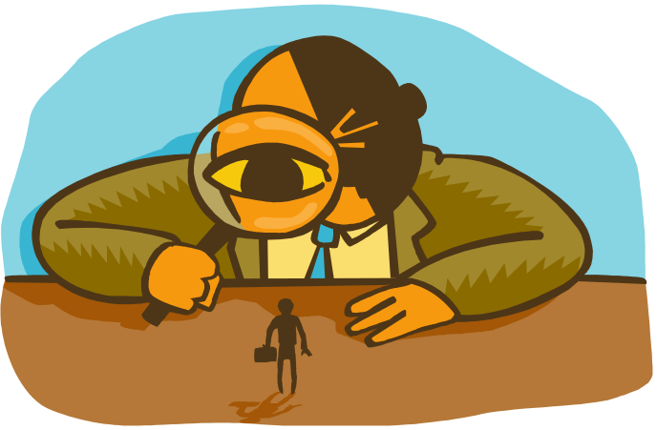
Person Perception: Making Judgments about others

Slide 29
Attribution
The Process through which individuals attempt to determine the causes of others behavior

Slide 30
Perception & Decision Making

Slide 31
Two Important
Decision-Making Phases
Problem
Identification
Alternative
Development

Slide 32
Why Do We Care?
Ability
PERFORMANCE
Motivation
Opportunity
Performance =
f (Ability, Motivation, Opportunity)

Slide 33

Groups Dynamics

Slide 34
Groups & Teams
Group - two or more people with common interests or objectives
Team - a small number of people with complementary skills who are committed to a common mission, performance goals, and approach for which they hold themselves mutually accountable

Slide 35
Group Roles
Task-Oriented
Roles:
Initiators
Information Seekers
Opinion Givers
Energizers
Relations-
Oriented Roles:
Harmonizers
Compromisers
Encouragers
Expediters
+
Task
Performance
+
-
Self-Oriented
Roles:
Blockers
Recognition Seekers
Dominators
Avoiders

Slide 36
The Communication Process
Encoding
Channel
Decoding
Message
Message
Source
Receiver
Feedback

Slide 37

Functions of Communication
Control
Motivation
Information
Emotional
Expression

Slide 38
Technology and Communication
Electronic Mail
The Internet
Notes:
14

Slide 39
Leaders & Managers

Slide 40
Trust and Leadership
Leadership
TRUST
and
INTEGRITY

Slide 41
Concept of Power
Power - the ability to influence another person
Influence - the process of affecting the thoughts, behavior, & feelings of another person
Authority - the right to influence another person
Notes:
2

Slide 42
Types of Organizational Politics
Managing
impressions
Attacking and
blaming
Types of
Organizational
Politics
Creating
obligations
Controlling
information
Cultivating
networks
Forming
coalitions

Slide 43
Conditions for Organizational Politics
Personal
Characteristics
Scarce
Resources
Conditions
Supporting
Organizational
Politics
Tolerance of
Politics
Complex and
Ambiguous
Decisions

Slide 44
Dependency: The Key To Power

Slide 45
Transitions in Conflict Thought
Traditional
View
Human
Relations
View
Interactionist
View

Slide 46
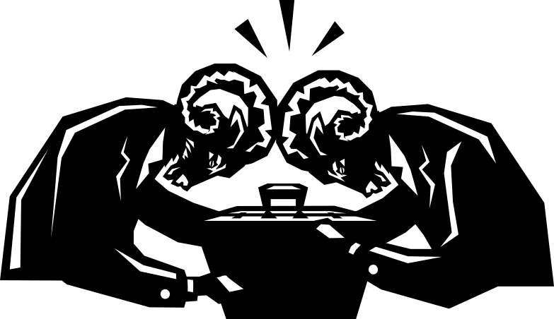
Conflict Management
Conflict at Work

Slide 47
Determine the Negotiation Outcome
Win/lose
Lose/lose
Win/win
Notes:
11

Slide 48

Third-Party Negotiations

Slide 49
Third-Party Objectives
Procedural
Fairness
Efficiency
Third-Party
Conflict Resolution
Objectives
Outcome
Fairness
Effectiveness

Slide 50
Group Decision Making
1) more knowledge through pooling of group resources
2) Increased acceptance & commitment due to voice in decisions
3) greater understanding due to
involvement in decision stages
Advantages
1) pressure in groups to conform
2) domination by one forceful member or dominant clique
3) amount of time required, because group is slower than individual to make a decision
Disadvantages

Slide 51
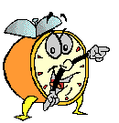
Let’s stop it here

Slide 52
Next….

Slide 53
Organizational Behavior
(MGT-502)
Lecture-29

